Slide 1

Short Intro to NLP
Menan Velayuthan

Slide 2
What is NLP and some Applications
Definitions

Slide 3
Definition of Natural Language
“Natural language processing (NLP) refers to the branch of computer science—and more specifically, the branch of artificial intelligence or AI—concerned with giving computers the ability to understand text and spoken words in much the same way human beings can.
NLP combines computational linguistics—rule-based modeling of human language—with statistical, machine learning, and deep learning models. Together, these technologies enable computers to process human language in the form of text or voice data and to ‘understand’ its full meaning, complete with the speaker or writer’s intent and sentiment.” - IBM

Slide 4
Few Applications of NLP
Spam Detection : Ability for machine to detect whether or not an email/message is a spam or not. The state of the art spam detection methodologies utilize Machine Learning and Natural Language Processing. (eg: Google or Yahoo mail spam detectors)
Machine Translation : For a long time it was one of the holy grail of NLP, with the introduction of Deeplearning models like Seq-to-Seq and transformer, translating from one language(eg: English) to another (eg: French) with high accuracy has been achieved. Eg: Google Translate.
Virtual agents and chatbots : Apple’s Siri is a great example for virtual agents using speech recognition to understand human commands and take actions accordingly. Chatbots are now extensively utilized as the first responders in many of the websites to pose inquiries.

Slide 5
Few Applications of NLP - Continued
Social media sentiment analysis : Knowing the pulse of the customers/market is key to any businesses, customer reviews and feedbacks are wealth of information on this regard. For a business which deals with a large volume of customers, it is very costly and inefficient to understand customer sentiments manually. And due to the unstructured nature of human language, it is difficult to predict or understand customer sentiments using rule based algorithms. NLP+ML models have proven effective in this field and businesses heavily utilize them nowadays.
Text Summarization : Text summarization utilizes NLP methods to summarize large volumes of text data and create synopses. This is a great application of information retrieval domain, where we can use key words or summaries to query research papers or documents from a large document database.

Slide 6
NLP Tasks
Part of Speech Tagging
Speech Recognition
Sentiment Analysis
NLP
Natural language generation
Word sense disambiguation
Co-reference resolution
Named entity recognition
Notes:
Speech recognition, also called speech-to-text, is the task of reliably converting voice data into text data. Speech recognition is required for any application that follows voice commands or answers spoken questions. What makes speech recognition especially challenging is the way people talk—quickly, slurring words together, with varying emphasis and intonation, in different accents, and often using incorrect grammar.
Part of speech tagging, also called grammatical tagging, is the process of determining the part of speech of a particular word or piece of text based on its use and context. Part of speech identifies ‘make’ as a verb in ‘I can make a paper plane,’ and as a noun in ‘What make of car do you own?’
Sentiment analysis attempts to extract subjective qualities—attitudes, emotions, sarcasm, confusion, suspicion—from text.
Word sense disambiguation is the selection of the meaning of a word with multiple meanings through a process of semantic analysis that determine the word that makes the most sense in the given context. For example, word sense disambiguation helps distinguish the meaning of the verb 'make' in ‘make the grade’ (achieve) vs. ‘make a bet’ (place).
Named entity recognition, or NEM, identifies words or phrases as useful entities. NEM identifies ‘Kentucky’ as a location or ‘Fred’ as a man's name.
Co-reference resolution is the task of identifying if and when two words refer to the same entity. The most common example is determining the person or object to which a certain pronoun refers (e.g., ‘she’ = ‘Mary’), but it can also involve identifying a metaphor or an idiom in the text (e.g., an instance in which 'bear' isn't an animal but a large hairy person).
Natural language generation is sometimes described as the opposite of speech recognition or speech-to-text; it's the task of putting structured information into human language.

Slide 7
Some Basic Terminologies

Slide 8
Before we dive into NLP methods we need first get familiar with some terms
The few terms we need understand are ,
Corpus
Documents
Tokens/Tokenization
Normalization
Stemming
Lemmatization
Stop words
N- grams
Bag of Words.
Vocabulary
Word Embeddings

Slide 9
Basic Terms - Continued
Corpus: Corpus(Plural :Corpora) is the collection of text eg: collection of movie reviews, comments collection, collection of articles. This is usually the dataset we have at hand.
Documents : Documents is one unit in the corpus. It can be one comment in a collection of comments or one article in a collection of articles. Therefore, a collection of documents make up a corpus.
Tokens and Tokenization: tokenization is, generally, an early step in the NLP process, a step which splits longer strings of text into smaller pieces, or tokens. Larger chunks of text can be tokenized into sentences, sentences can be tokenized into words, etc. Further processing is generally performed after a piece of text has been appropriately tokenized.

Slide 10
Basic Terms - Continued
Normalization: Is the process of brining the text in the corpus to a common ground. This is an essential text preprocessing step. Eg: “Home” → “home”, (lowercasing all the text)
Stemming : Stemming is the process of eliminating affixes (suffixed, prefixes, infixes, circumfixes) from a word in order to obtain a word stem. (rule based methods) Running → Run
Lemmatization: Lemmatization is related to stemming, but how it differs from stemming is that it is able to capture canonical forms based on a word’s Lemma better → good

Slide 11
Basic Terms - Continued
Stop Words: Stop words are words which contribute less for the overall meaning. They are essential to maintain a structure of a sentence but won’t add value for the NLP task at hand. Note : We will see why we need to eliminate these words by looking at Zipf’s Law specially for statistical methods Eg: In the sentence: “The cat sneaked to the behind door. Here words like “the” and “to” are considered stop words.
N-grams: is one type of representation model, where we take N sequences of text to form a unit of text.
Eg: “The boy walked last.
uni-gram(1-gram) : [“The”, ”boy”, ”walked”, ”last”]
bi-gram (2-gram) : [“The boy” ,”boy walked”, ”walked last”]
tri-gram (3-gram) : [“The boy walked” , ”boy walked last”]

Slide 12
Basic Terms - Continued
Bag of Words (BoW) : Is one of the simplest representation in NLP. In this model a document (sentences, articles etc) is represented by a set of words, disregarding grammar or the order of the words, like taking the words and putting it into a bag.
Eg : “John likes to watch movies. Mary likes movies too.” set of words : "John","likes","to","watch","movies","Mary","likes","movies","too“
BoW of the document : {"John":1,"likes":2,"to":1,"watch":1,"movies":2,"Mary":1,"too":1}
Vocabulary: The entire set of terms used in a body of text.
Word Embedding: Each token is embedded as a vector before it can be passed to a machine learning model. While generally referred to as word embeddings, embeddings can be created on the character or phrase level as well. Following the techniques section is an entire section on different types of embeddings

Slide 13
NLP modeling can be categorized as 2 types
NLP Modeling
Statistical Methods
Eg: Count vectorizing (using BoW), Tf-IDf
Machine Learning Methods
Eg: Word2Vec, RNNs, LSTMs, Transformers.

Slide 14
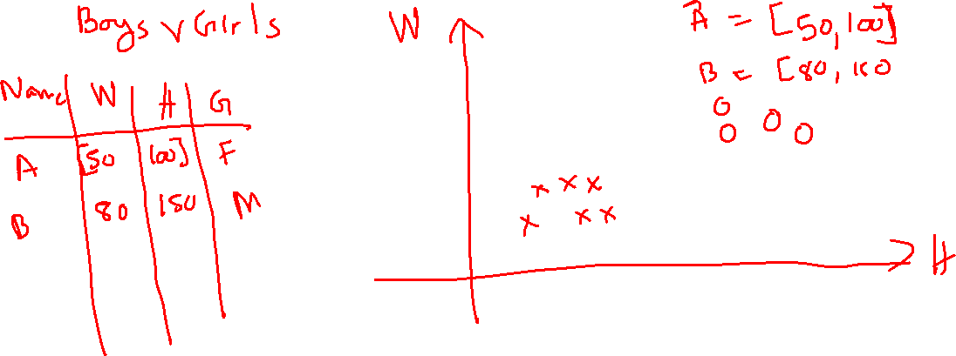
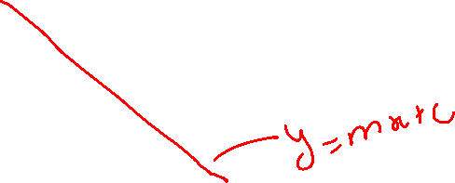
What is Representational Learning?

Slide 15
Example of BoW demo

Slide 16
Resource to learn TF-IDF
Tf-IDF has many applications, it is used to extract keywords from large articles, this can be a preprocessing task for Topic Modelling.
Links : Link1 Link2

Slide 17
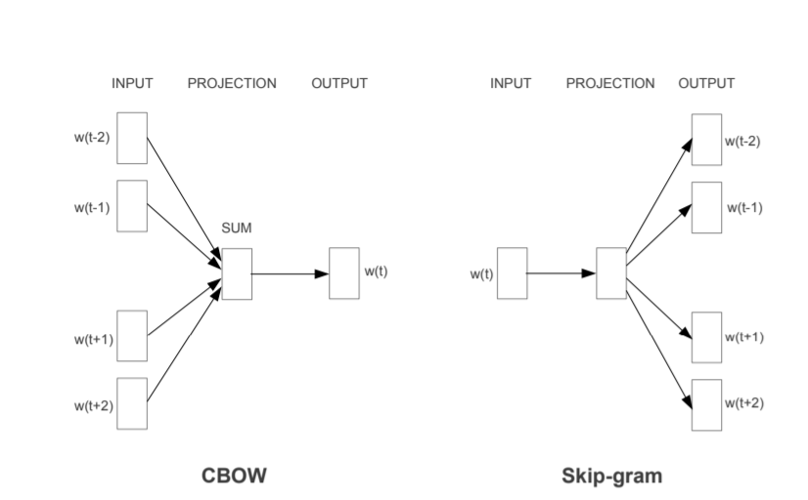
Word2Vec
Know your neighbors “A man is known by the company he keeps”
Model based off the paper “Efficient Estimation of Word Representations in Vector Space” by Mikolov et al. (2013).
2 Models are proposed in the paper.
Continuous Bag of Words (CBOW).
Continuous Skip-gram Model.

Slide 18
Word2Vec - Continued
Illustrating the Word2Vec through an excellent article
https://jalammar.github.io/illustrated-word2vec/

Slide 19
Word2Vec Demo
Demo code is mainly edited from this source code by Pradip Nichite Link

